Slide 1
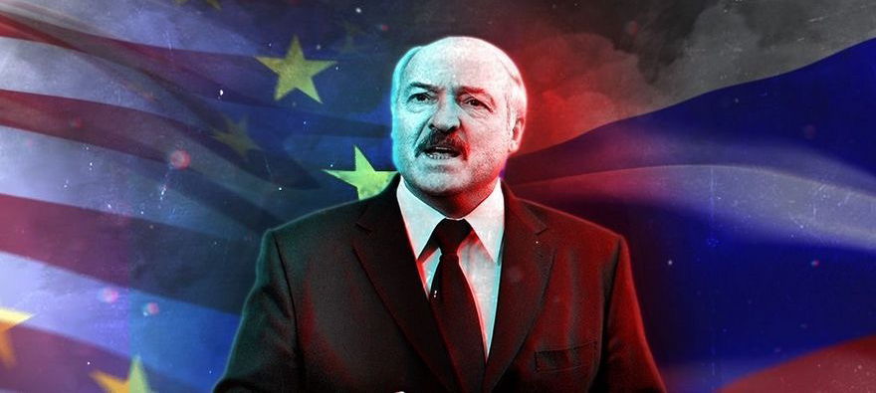
Belarus-Russia: from a Strategic Deal to an Integration Ultimatum
Arseny Sivitsky
Vienna, ICEUR|November 11, 2019

Slide 2
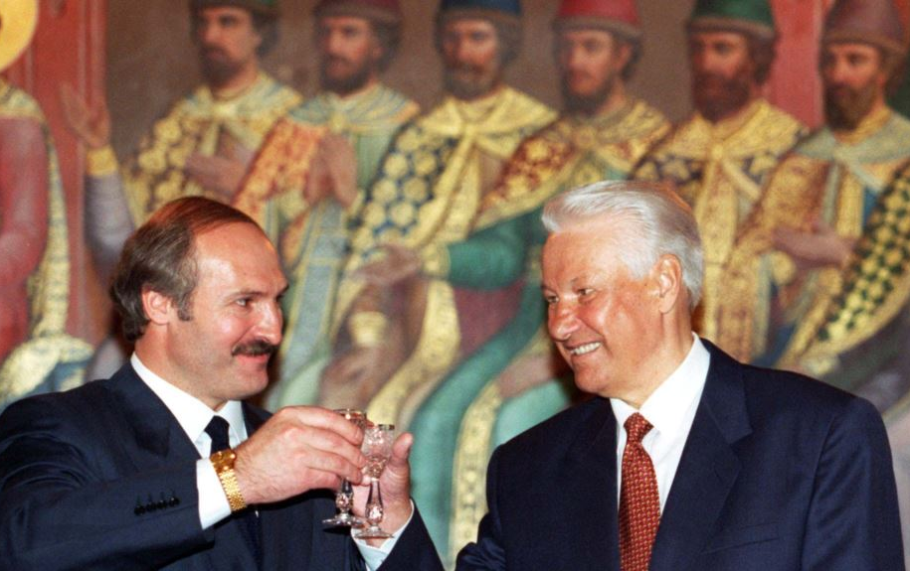
Strategic Deal with Russia
In 1996, Lukashenko announced economic and military-political integration with Russia as the main priority of the foreign policy
Belarus signed a number of economic, political and military treaties with Moscow, culminating in the agreement of establishing the Union State of Belarus and Russia in 1999
Russian financial and economic support in exchange for a certain degree of geopolitical loyalty and integration aspirations on the part of Belarus

Slide 3
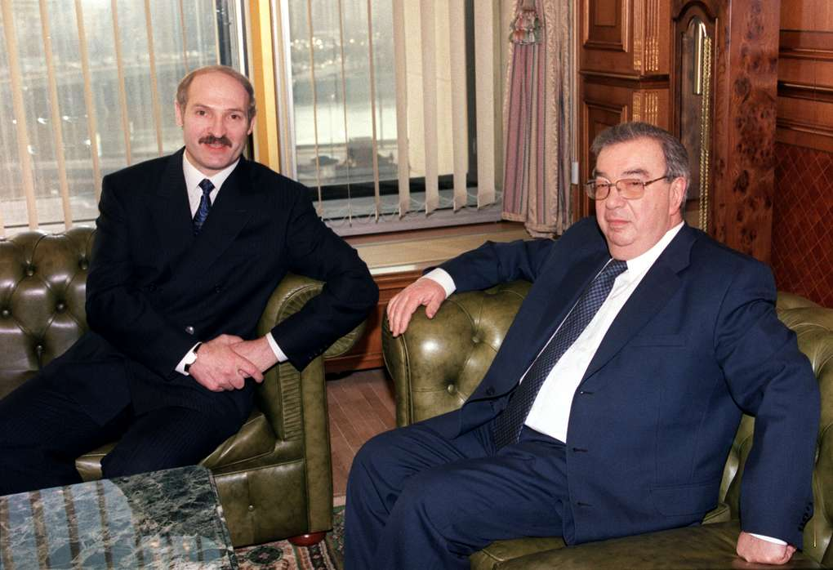
Strategic Importance of Belarus for Russia
Russian Institute for Strategic Studies of the Foreign Intelligence Service, SVR (1996):
Geopolitical interests should prevail in Moscow’s strategy towards Minsk
Military cooperation should not be solely guided by economic terms
Strengthening of relations is a strategic interest
It guarantees its national security in western direction, as it allows the normal deployment of Russian troops in Kaliningrad

Slide 4
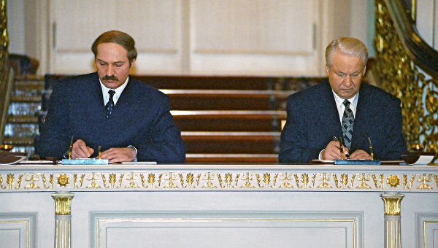
Union State of Russia and Belarus (1999)
Lukashenko’s ambitions to become a new master of Kremlin
Resistance of Anatoly Chubais and Boris Berezovsky, who promoted Vladimir Putin
Lukashenko’s successful exploitation of Moscow’s phobia for the West
Belarus now seems to have fallen into an integration trap artfully set by Moscow

Slide 5
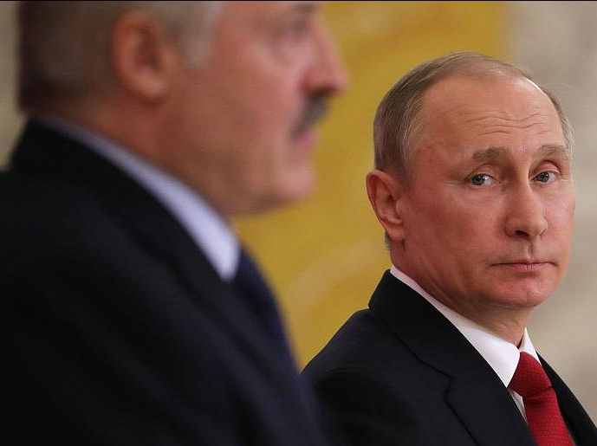
Evidence of Shifts in RU-BY Relations
Economic Shift: Drop in Integration Subsidies (2015)
Strategic Shift: Coercion to a Deeper Political-Military Integration (2015)
Kremlin’s deeper integration ultimatum (2018)
Strategic assessments of Russian Inteligence community (geopolitical phobia)
Dramatic shift in debates on Belarus: developing contingency plans

Slide 6
Economic Shift: Drop in Integration Subsidies (2015)

Slide 7
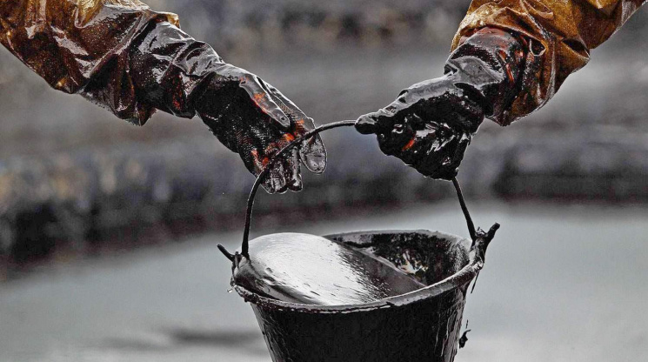
Tax Maneuver in Oil Industry of Russia
Before 2015 Belarus bought Russian oil for half the market price — now that has been reduced to a discount of 25-30%
With the formation of a single market for oil, gas and oil products in the Eurasian Economic Union by 2025 Belarus will have to pay standard market prices
That will mean the end of the Russian ‘integration subsidies’ for the Belarusian economy
Global losses will amount to about $10 billion (one sixth part of 2018 Belarus’s GDP)

Slide 8
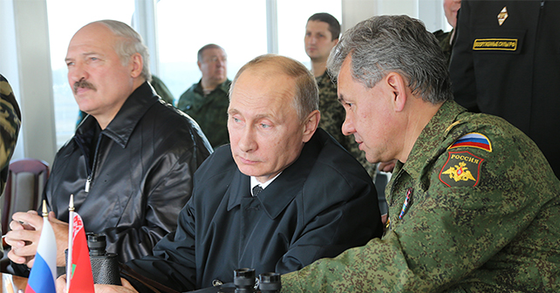
Strategic Shift: Coercion to a Deeper Political-Military Integration (2015)
Russian military airbase in Belarus in 2015
Reassigning the Belarusian Armed Forces to the Western Military District (Armenian model)
Creation of a joint military organization (Abkhazian and South Ossetian models)

Slide 9
Kremlin‘s Integration Ultimatum (2018)
Preservation of integration subsidies is conditional to a new deeper integration
Reference to the 1999 Treaty on the Union State
Economic integration is the first stage, the second – political and military integration
Russia is not satisfied by current status quo (formal equality of Russia and Belarus within the Union State)
Moscow reconsiders terms and conditions of the strategic deal of 1990s, while Belarus is still committed

Slide 10
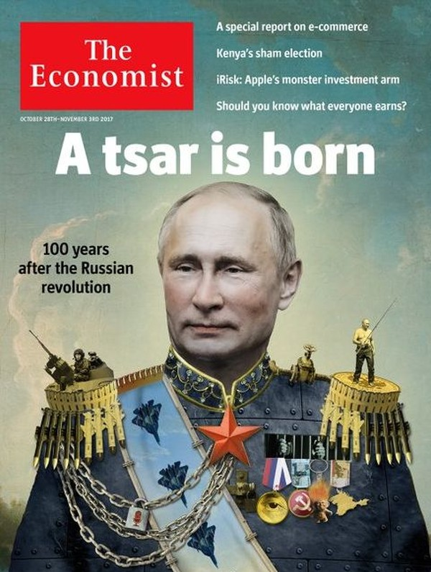
Scenario for 2024?
Union State – one of possible scenarios of power transfer after Vladimir Putin’s last presidential term in 2024
Finalization of the Union State of Belarus and Russia through in-depth economic and military-political integration with a common Constitution, presidency, army and currency
However, a geopolitical motivation prevails rather then domestic reasons

Slide 11
Dramatic Shift in Debates: Contingency Plans
Military bases and in-depth military integration
Coercion to the deeper integration
Regime change in Minsk
Military intervention after 2024 (if it is the only available option to keep Belarus in the Kremlin’s geopolitical orbit)

Slide 13
Thank you for your attention!

